Slide 1

AI BASED TOOL TO ASSIST VEHICLES IN DETECTING OBJECTS TO AVOID ACCIDENTS.
Team members:
2010030536- Shravan
2010030033-Santosh
2010030358-Avinash
2010030513-Akhil
Guide :
Dr . Rama Rao

Slide 2



Table of contexts
CONTEXT
Literature survey
ABSTRACT
Our approach to the project
Flow chart
CONCLUSION

Slide 3
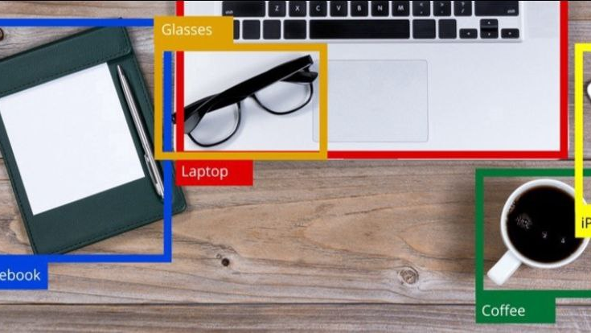
CONTEXT
In India every year nearly 4 to 5 lakh accidents happen .in those accidents almost 2 to 3 lakh people die.
Many of these accidents happen due to reasons like obstacles on the road and low visibility during night.
These minute human errors are making such huge losses to the society.

Slide 4
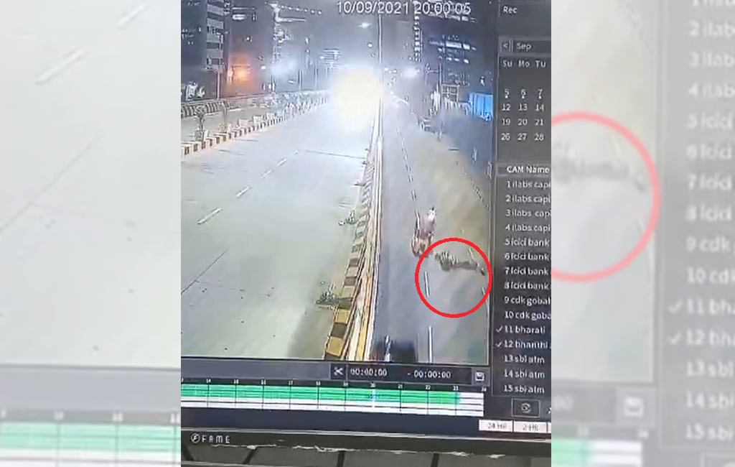
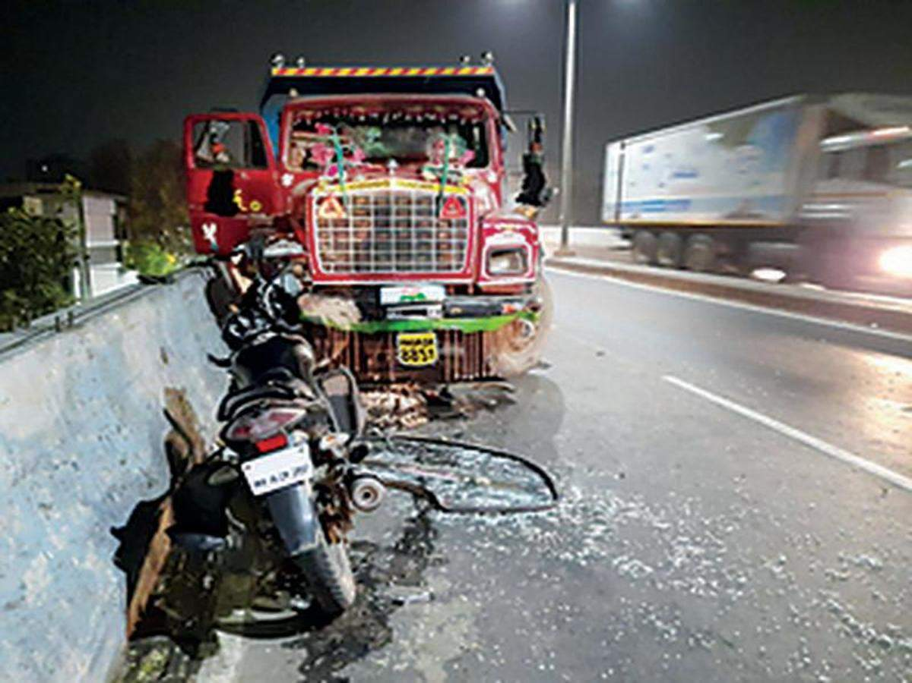

Slide 5
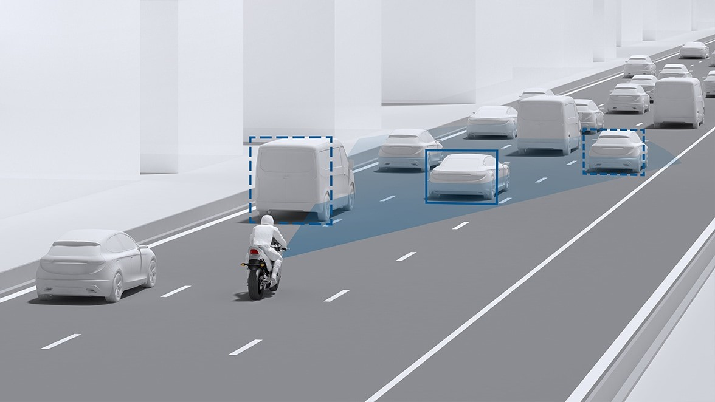
AI BASED TOOL TO ASSIST VEHICLES IN DETECTING OBJECTS TO AVOID ACCIDENTS

Slide 6
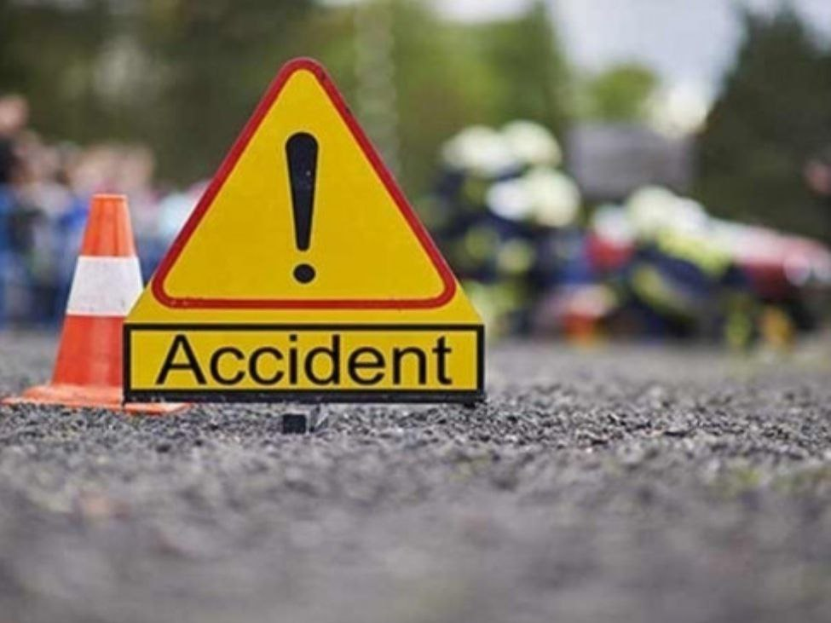
Problem statement
On a survey ABOUT TWO WHEELER ROAD ACCIDENTS , WE CAME TO KNOW THAT UPTO 60% OF ACCIDENTS HAPPEN AT NIGHT TIME.
MOST OF THESE ACCIDENTS AR LEAD BY PITS ,SAND, ROCKS AND OTHER OBSTACLES ON THE ROAD.
DUE TO LOW VISIBILITY AT NIGHT TIME THESE OBSTACLES CAN’T BE SPOTTED BY THE RIDER.
TO OVERCOME THE ABOVE SCENARIOS THERE IS NO EXISTING TECHNOLOGY .
SO WE WANTED TO EXPLORE THIS PROBLEM THROUGH OBJECT DETECTION.

Slide 7
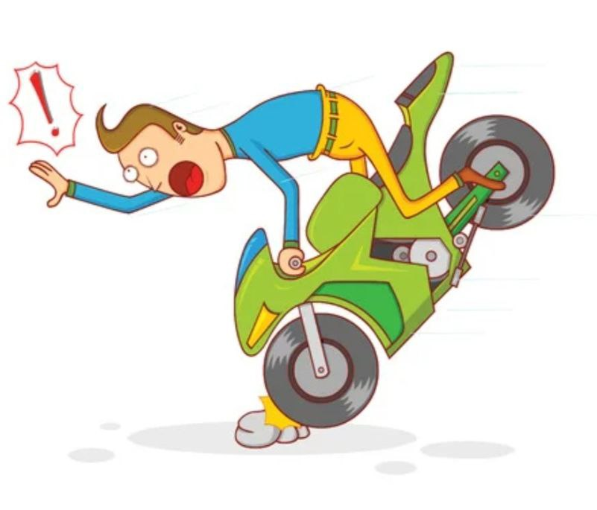
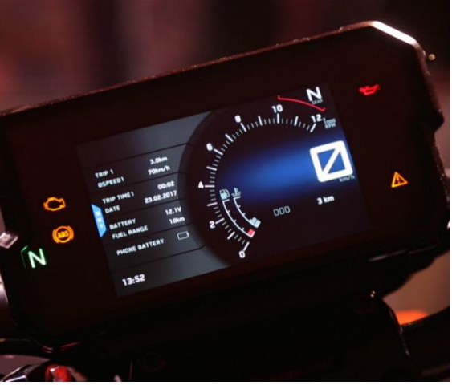
ABSTRACT :
The main purpose of this project is to build a object detector in vehicles to detect the obstacles(such as sand piles ,pits and rocks )
We want to indicate the obstacles by displaying obstacles on speed display meter
To convey the details of detected object in form of text message along with a voice command.

Slide 8
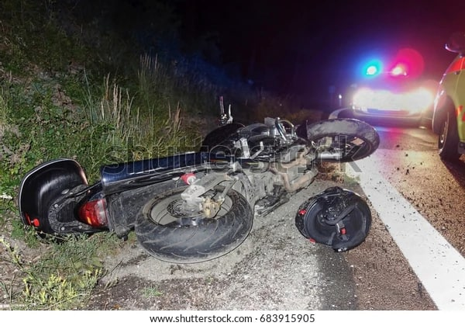
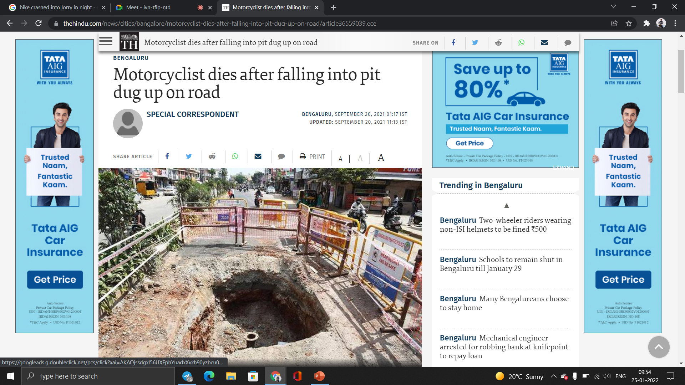

Slide 9


OUR APPROACH TO THE PROJECT

Slide 10
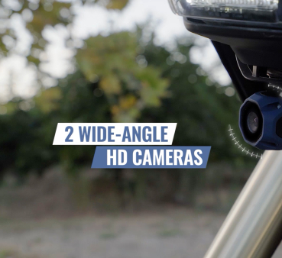
STEP 1-INPUT
THE INPUT IS CAPTIVATED FROM A CAMERA FIXED TO THE BIKE HEADLIGHT.
THE CAMERA USED WILL BE A 4k resolution WIDE ANGLED CAMERA FOR BETTER RESULTS.

Slide 11
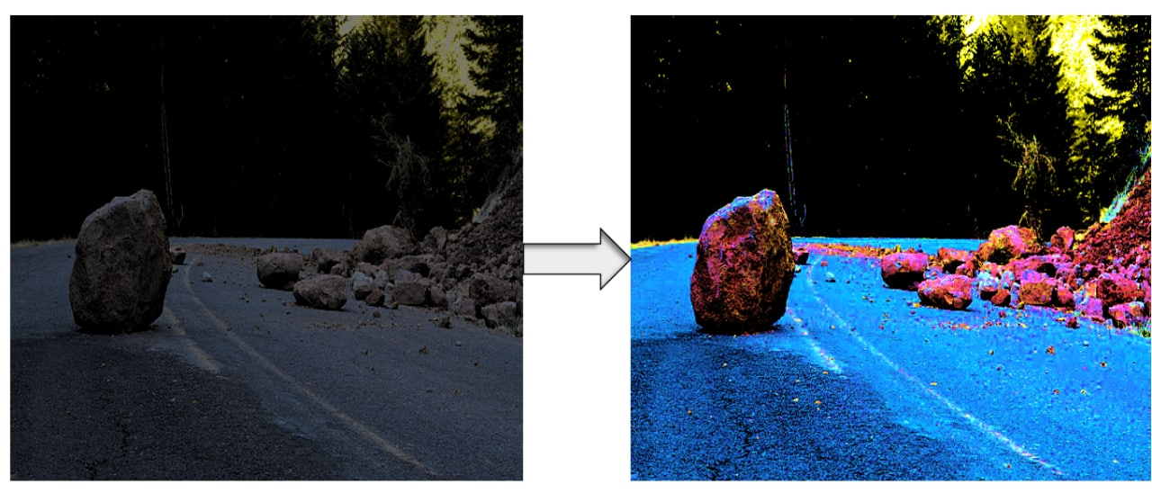
STEP 2- IMAGE ENHANCEMENT
THE IMAGE will be RECEIVED BY THE Arduino Attached TO THE CAMERA.
As the pictures are taken at night time, to enhance the clarity some changes are made . (increasing brightness , contrast, adjusting saturation)
For this enhancement we will be using retinex algorithm.

Slide 12
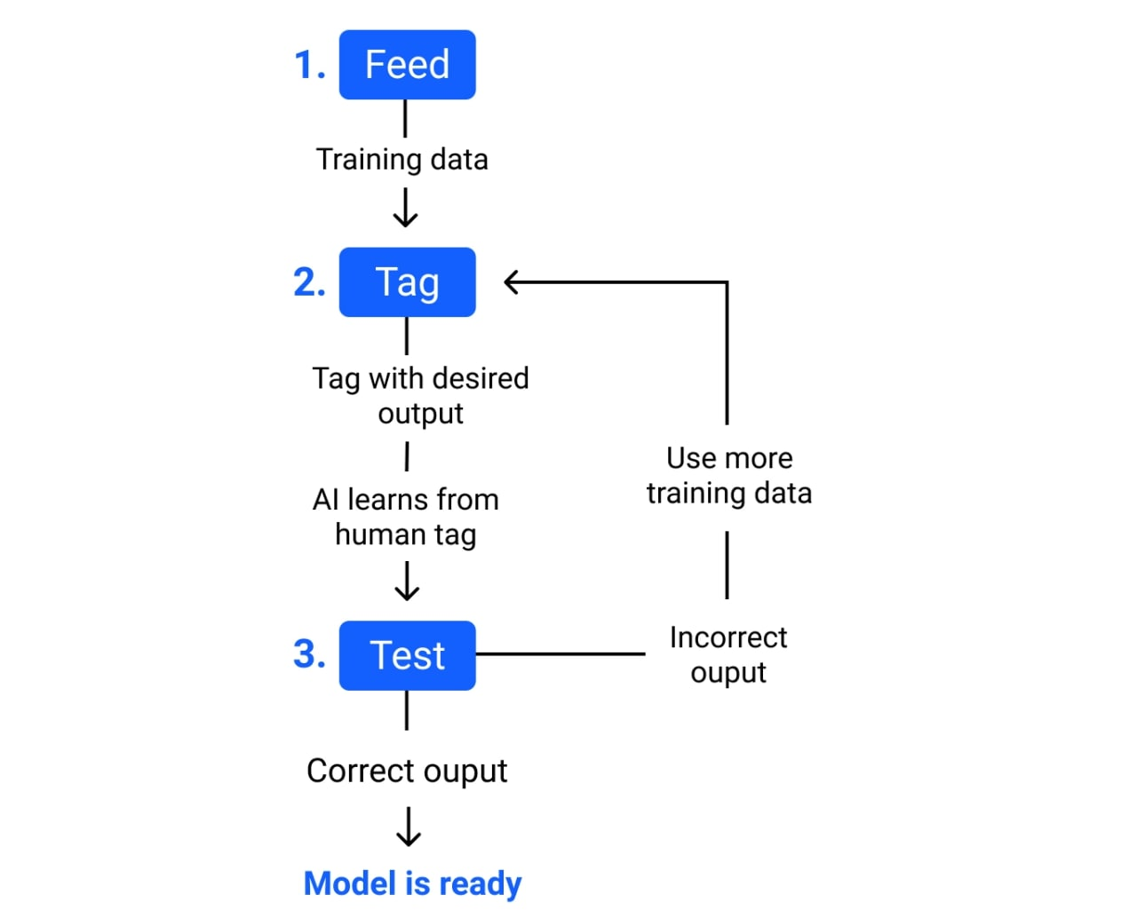
Step 3-Dataset training
Here we will be training our software by providing proper datasets.
1. Feed- to input data for training a machine learning model .
2. Tag- name the training data with a desired output. The model transforms the training data into text and vectors – numbers that represent data features.
3. Test-test the model using new inputs .if it gives correct output the model is ready. If not train the model with few more datasets.

Slide 13
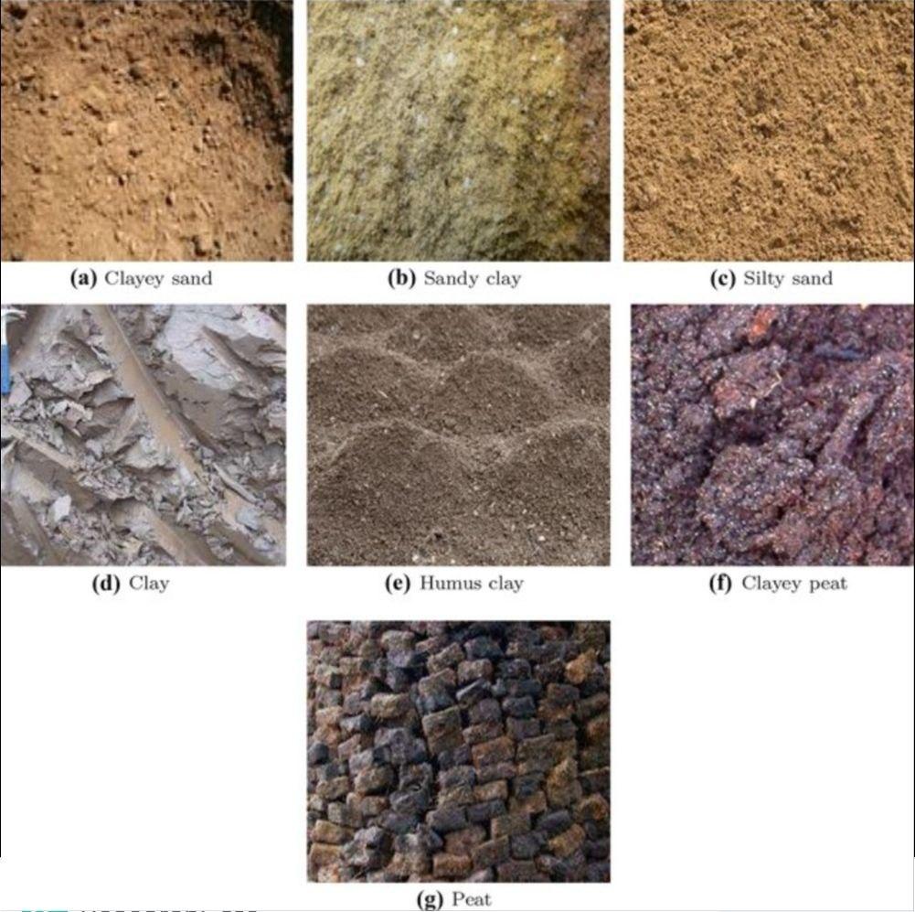
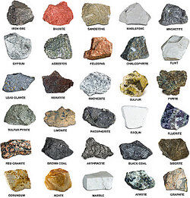
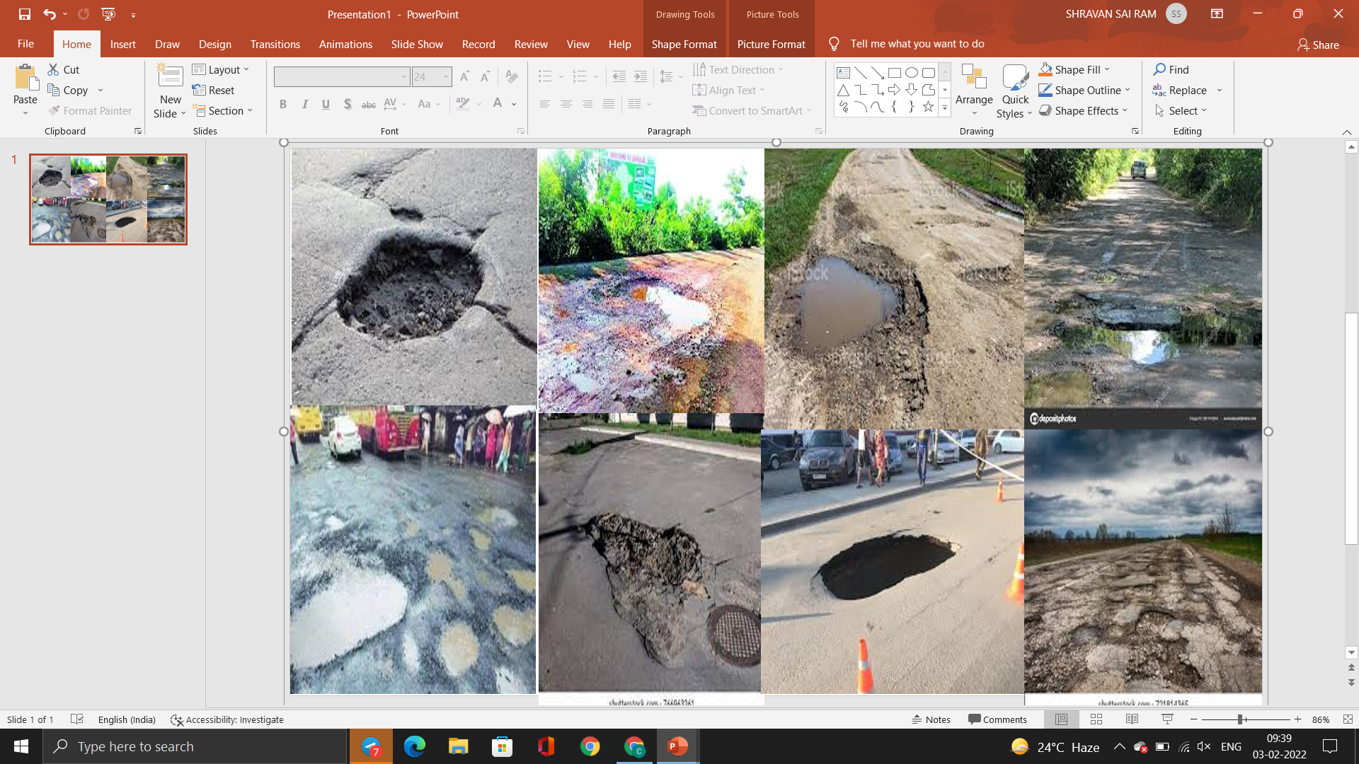
Images of few datasets

Slide 14
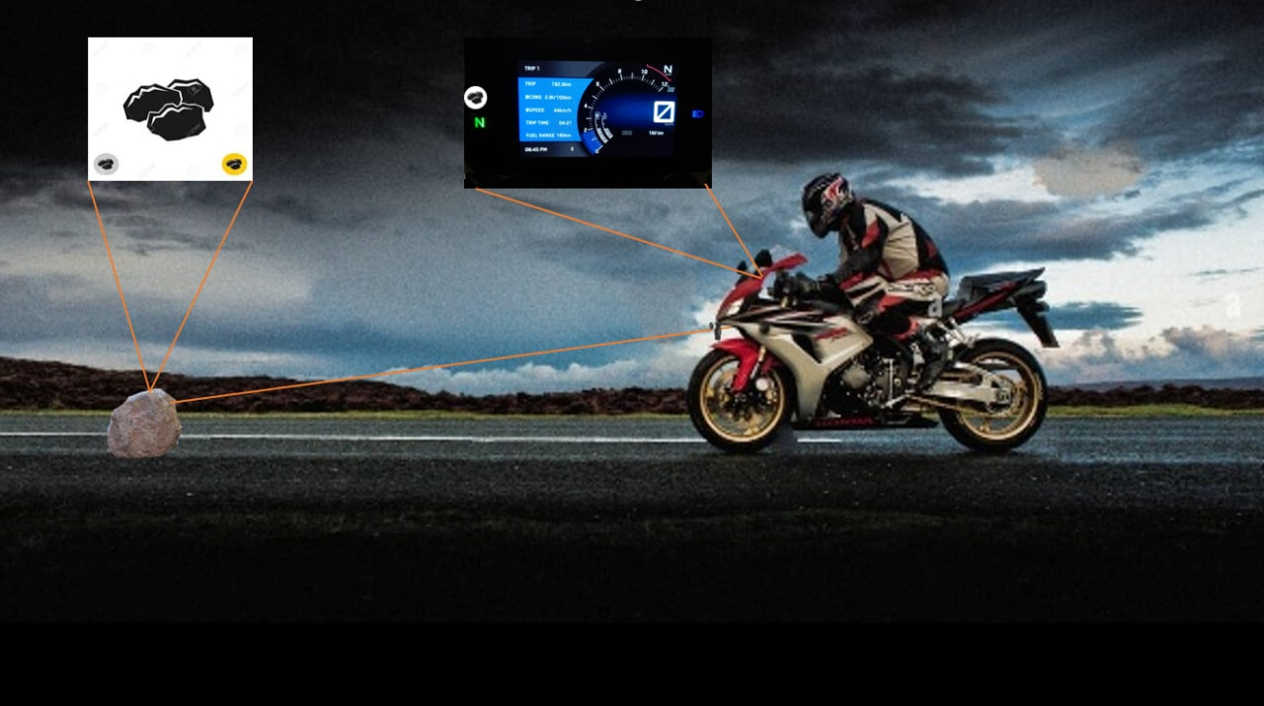
STEP-4 IDENTIFICATION AND DETECTION
THE PROCESSED IMAGE will be IDENTIFIED ACCORDING TO ITS DATASET (SAND, ROCKS AND PITS).
For image identification and detection we will be using yolov3 algorithm.
We will be using OpenCV , keras and TensorFlow libraries for this step.
AS THE IMAGE IS IDENTIFIED THE INSTRUCTION will be GIVEN TO proceed with the output .

Slide 15
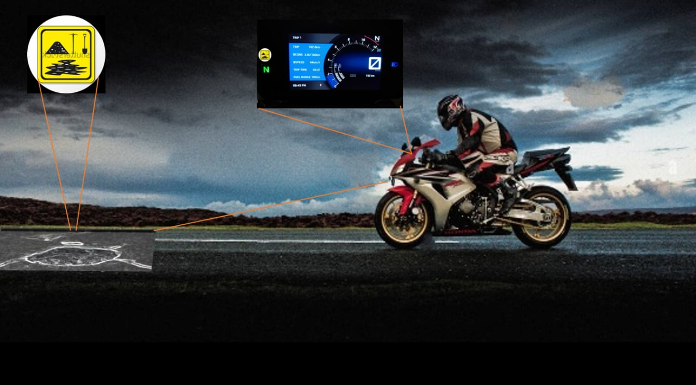
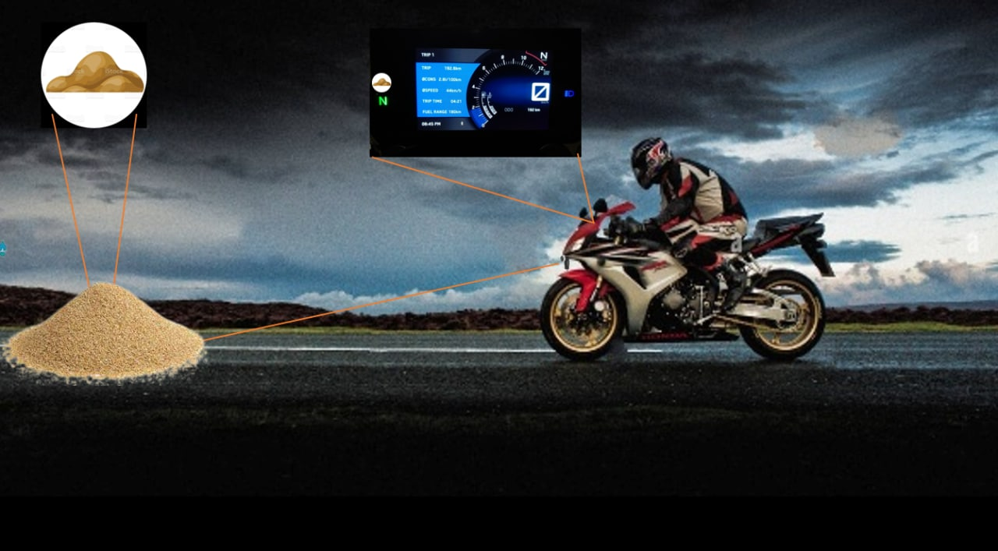

Slide 16
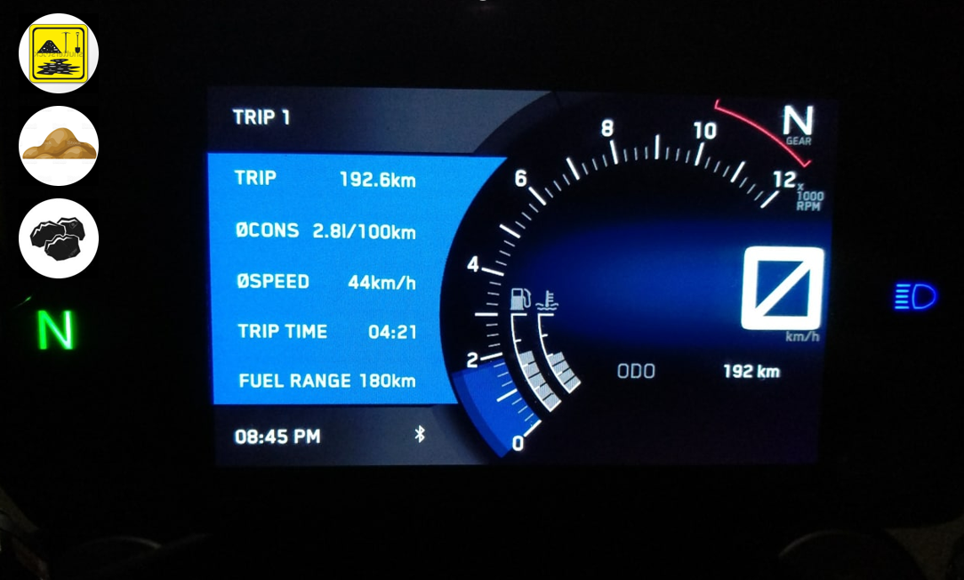
STEP-5 OUTPUT
THE OUTPUT will be IN THE FORM OF PICTURE and an VOICE COMMAND.
THE PICTURE will be DISPLAYED ON THE digital SPEEDOMETER.
The voice command will be passed on to the rider’s helmet via Bluetooth.

Slide 17
Flowchart of object detection

Slide 18
Capturing Images
IMAGE ENCHANCEMENT
Feeding images
Dataset loading
If fails
Dividing picture into blocks
DATASET TRAINING
Manual screening
Picture identification
IDENTIFICATION
AND DETECTION OF DATASETS
If passed
Display symbol/voice command
Final dataset
Dataset comparsion

Slide 19
CONCLUSION
By choosing this topic, we have aimed to produce optimized solution for the obstacles that have come up in the experiments we have seen till date.
Our product will be useful in road condition monitoring and prevent accidents during night time .
Our attempt here is to try to develop a better solution for object detection in vehicles .
In addition to that we are also attempting to convey the info of detected objects to the rider in an efficient manner.

Slide 20


